Slide 1
myDRE
Activity

Slide 2
Definitions
ACTIVTY is measured via:
Start Virtual Machine Succeeded
Ignores ingress activities
Ignores egress activities
Ignores people entering a running Virtual Machine
Ignores Virtual Machines with autoshutdown=False
I.e., actual activity can be higher
In Collaborations, all ‘@mydre.org’ is removed

Slide 3
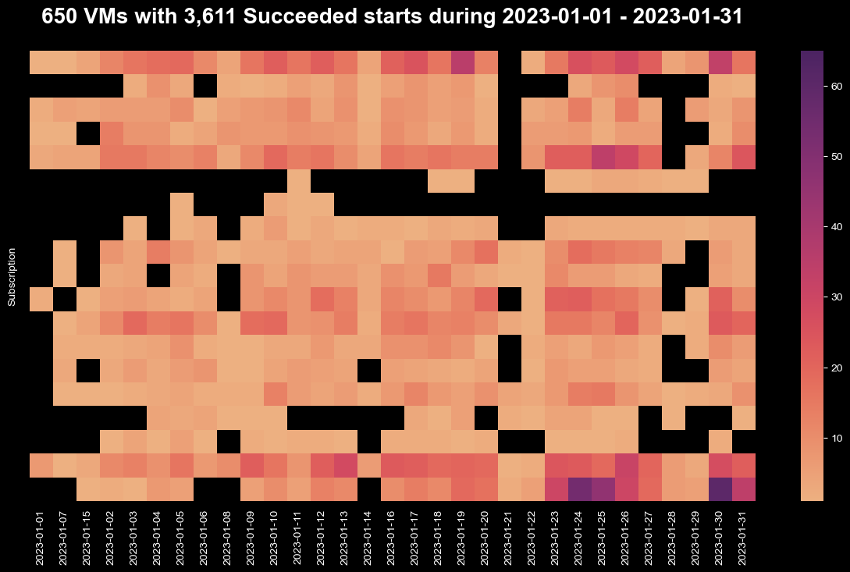

Slide 4
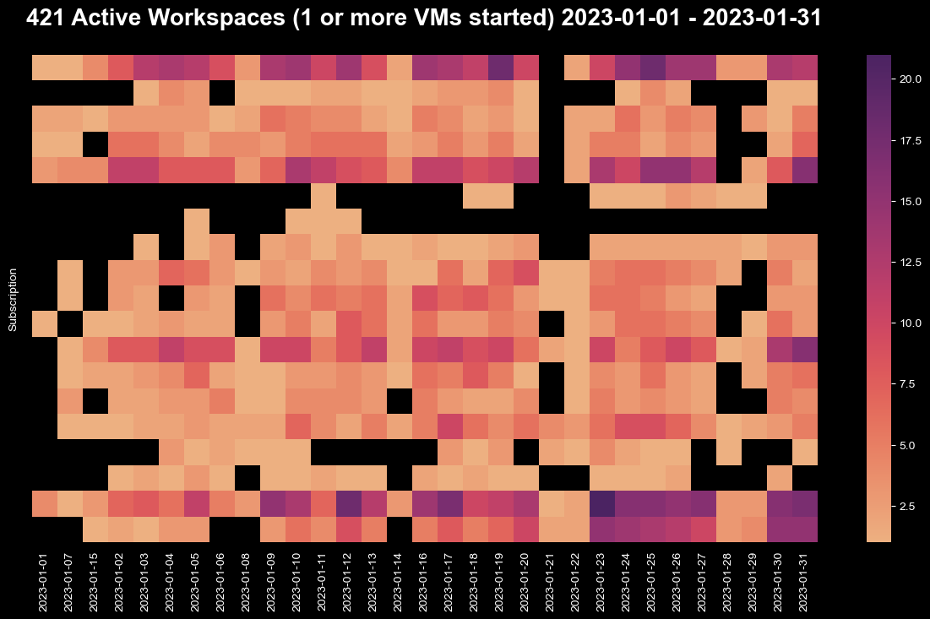

Slide 5
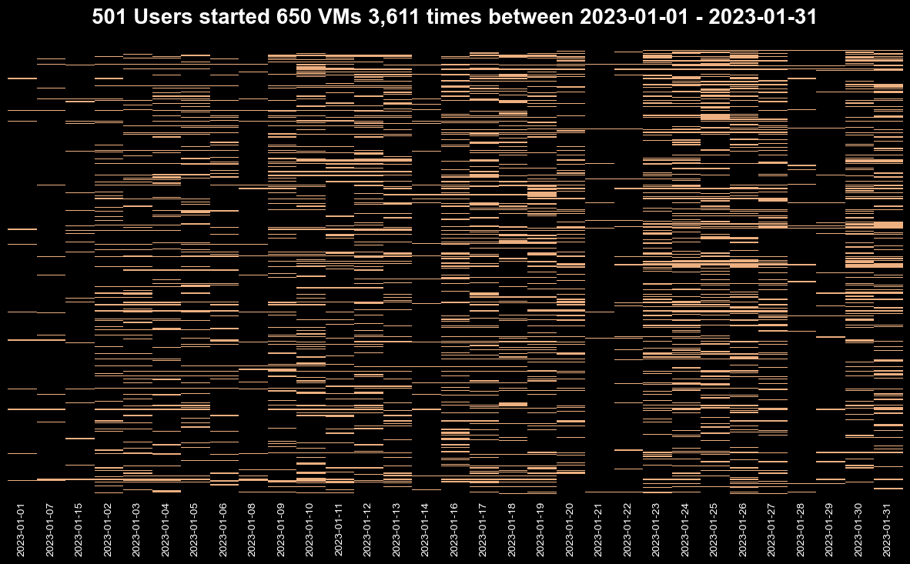

Slide 6
